Slide 1


Trident Limited
Home Textile I Paper
BY SHREY PANTHRI 2K21/B16/23
SAHIL SHARMA 2K21/B16/02
SARTHAK TONK 2K21/B16/12

Slide 2
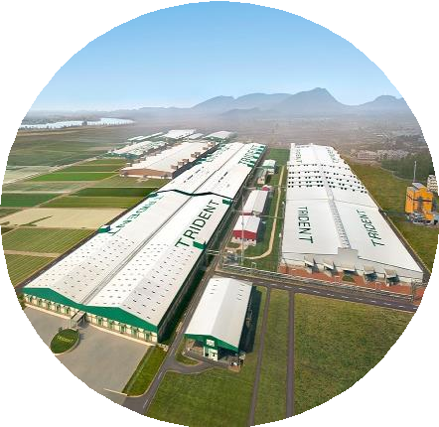








Trident’s – A distinctive Entity
A
Leading Integrated home textile manufacturers
with 30+ year track record
B
World’s Largest wheat straw-based paper manufacturer
USD 3bn+
Business Group
150+
countries
#1
in North India for Branded Copier segment
C
D Globally Best-in-class Business Partners
World-class Infrastructure & Technology
67%
Exports
17,000+
employees
12+
Patents
46+
E-com website
presence
E
Robust Financials and
Young & Energetic Workforce

Slide 3







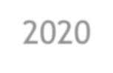




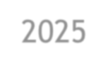
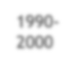
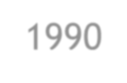

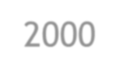


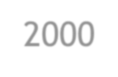


Trident’s Transformation Journey
Going Forward
Make Trident a National Brand
☑
E-commerce Website
Retail Outlets
Social Media Presence
Diversified products
Started as a Commodity Player
☑
☑
Forayed into Terry Towel in 1998-99
Digital Trident – Completing Industry 4.0 Journey
Inception: Started as a yarn manufacturer in 1990 with just 17k spindles
Transition &
Diversification Phase
2010-
2020
E-sourcing
Real time performance monitoring
AI enabled Projects
Digitalization of products
Virtual showrooms
Entered Paper, Chemical &
Energy segment
2020-
2025
Enhanced capacity
1990-
2000
expansion in Yarn and Terry
towel
2000-
2010
Value Addition &
Consolidation Phase
Horizontal diversification into
segments such as Bed Linen
Strengthened presence in
E-commerce and domestic market
Secured 10 patents

Slide 4
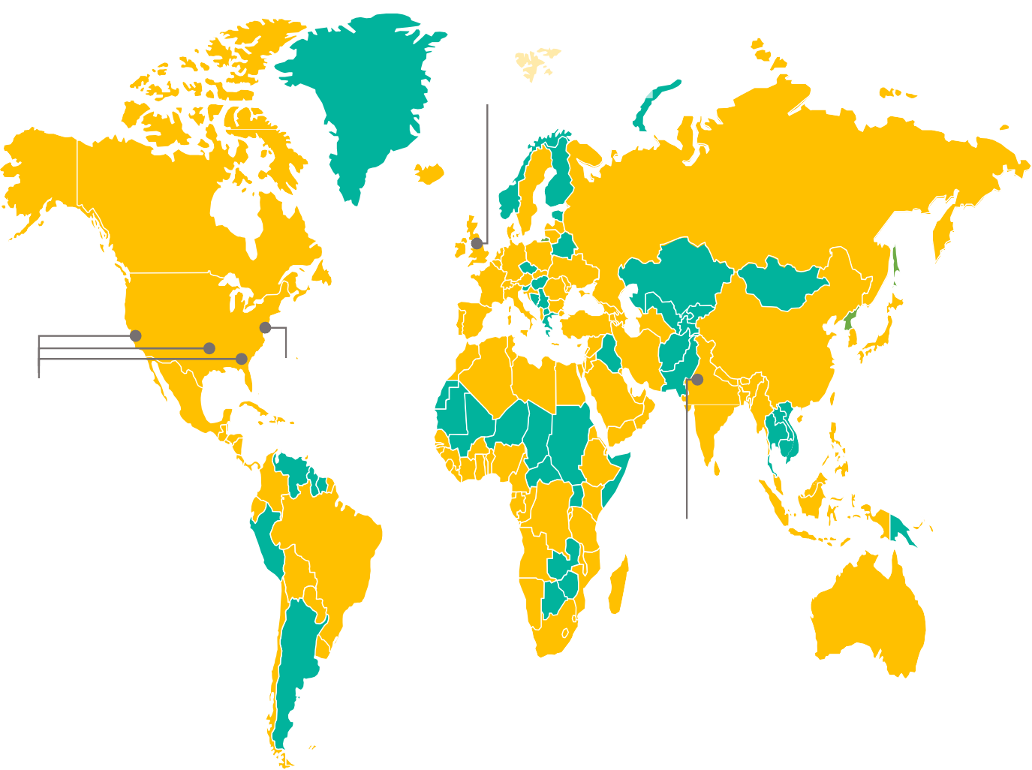

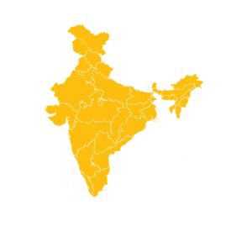




Global Presence
Across 6 continents and 150 countries
Trident Europe Ltd.
First Floor, Sovereign House, Stockport Road,
Cheadle, Cheshire, England – SK82EA
Trident UK Office
Corporate Headquarters Manufacturing Unit Sales / Liaisoning Office
Warehousing & Distribution Set
up
Trident NYC Office
US Office:
295, Fifth Avenue,
Suite 612, New York,
NY 10016, USA
Trident Head Office
Trident Presence

Slide 5







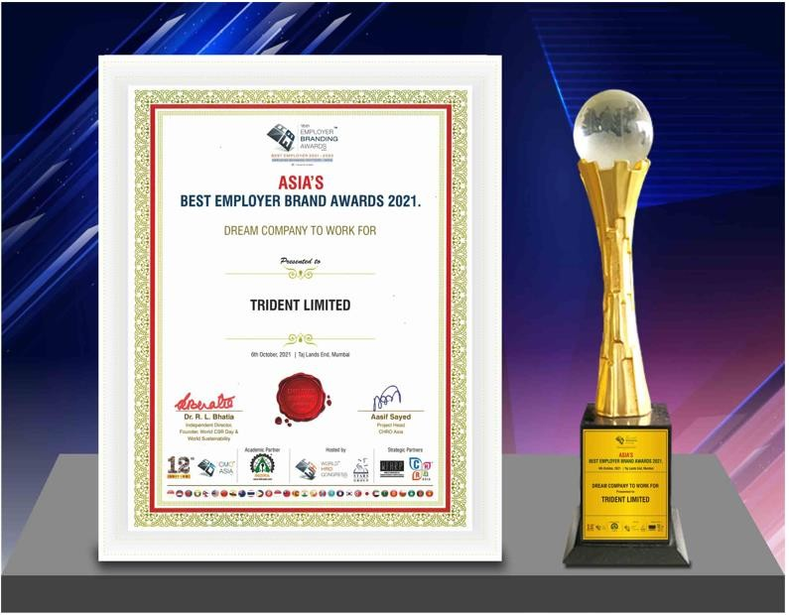
Awards & Recognition

Slide 6















































MAREKT LINKAGES
DDoommeessttiicc hhoommee tteexxttiillee bbrraannddss
InIntteerrnnaattiioonnaall hhoommee tteexxttiillee bbrraannddss
MMaarrqquueeee CCuussttoommeerrss
Bed
Bed
Bed
Bed
Bath
Bath
Trident’s home textile brands are across a range of luxury, premium, essentials, exclusive and gifting products

Slide 7

Snapshot Q4 FY22
Total Income
Rs 18,531 Mn
EBITDA Margin
18.00%
PBT Margin
12.63%
Free Cash Flow
Rs 5,569 Mn
Management’s Commentary:
“Despite the high commodities prices, inflationary issues, and supply chain constraints, we
delivered resilient performance for our stakeholders during the year.
We remain optimistic about the future growth of the industry and hope to maintain likewise momentum going forward.”
Mr. Rajinder Gupta
Chairman, Trident Group
Capacity Utilization Revenue Segment
120%
100%
80%
60%
40%
96%
Q4 FY21
Q4 FY22
83%
92%
80%
92%_{89%}
61%
Q4 FY21
2184
2773
Figures in INR Millions (Mn)
46%
Q4 FY22
3110
9040
20%
0%
8208
6655
Yarn
Towel
Sheeting
Paper
Bed & Bath Linen
Yarn Business
Paper
Bed & Bath Linen
Yarn Business
Paper

Slide 8


Shareholding and Dividend Payout
Key Market Statistics (30th May 2022) (INR)
Shareholding Pattern (31st March 2022)
BSE Ticker 521064
NSE Ticker Trident
Bloomberg code TRID:IN
25%
Promoters
Reuters TRIE.NS
Non-Promoters- Non Public
Market Price 48.05
2%
Market Cap (in million) 2,44,863
73%
Public
Outstanding shares (in million) 5096
Face value per share 1
Dividend
52 week low/high 15.7/70.3
65%
53%
Stock price movement
50%
60
50
40
30
53.4
53.7
27%
35%
29%
28.0
0.15
0.15
0.30
0.36
0.36
0.36
20
10
0
7.0
6.7
9.9
14.1
16.4
FY17
FY18
FY19
FY20 FY21
Dividend payout ratio
FY22
4.25
Mar-20 Jun-20 Sep-20 Dec-20 Mar-21 Jun-21 Sep-21 Dec-21 Mar-22
Series1
Dividend

Slide 9
Financial Performance
REVENUE
EBITDA
54%
58%
56%
67%
65%
19.6%
19.4%
18.3%
18.2%
21.7%
46,403
52,653
47,240
45,353
69,415
9,140
10,292
8,653
8,270
15,100
FY18
FY19 FY20
Revenue (in INR million)
FY21
Exports
FY22
FY18
FY19 FY20
EBITDA (in INR million)
FY21
EBITDA Margin
FY22
PBT
PAT
15.7%
11.7%
8.0%
10.0%
9.0%
10.0%
7.0%
7.2%
7.6%
5.7%
3,918
5,469
4,212
4,452
10,916
2,659
3,709
3,418
3,457
8,150
FY18
FY19 FY20
PBT (in INR million)
FY21
PBT margin
FY22
FY18
FY19 FY20
PAT (in INR million)
FY21
PAT margin
FY22

Slide 10


Segment Overview
Textiles
Paper
Largest Player in terms of Terry Towel Capacity & One of the largest players in Home Textile Space in India
Highest Operating Margin among Key Listed Players in India
Revenue Split between segments
FY22 58%
FY21
FY20 54%
FY19 51%
FY18 48%
28%
14%
64%
20%
16%
26%
20%
30%
19%
33%
19%
Bath & Bed Linen
Yarn
Paper

Slide 11
Segmental Performance Annual
Revenue Mix
Capacity -Towels (in 000’tons)
Capacity-Bed Linen (In Mn meters)
iles
ext T
me Ho
45%
49%
53%
61%
80%
88%
18.4%
48%
63%
60%
Textiles
44%
6.0%
8.0%
8.0%
10.0%
37799
42229
37776
38161
59422
90.0
90.0
90.0
90.0
90.0
43.2
43.2
43.2
43.2
43.2
FY18
FY19 FY20
Sales (in INR million)
FY21 FY22
EBIT Margin
FY18
FY19
FY20
FY21
FY22
FY18
FY19
FY20
FY21
FY22
Capacity
Utilization
Capacity
Utilization
Revenue Mix
Copier vs Non-Copier Revenue Mix
Capacity Utilization (Tonnage Basis)
89% 89% 90%
32.0%
37.1%
33.6%
86%
Paper
25.9%
23.8%
40%
r
ape
P
Copier
Non-Copier
79%
8579
9970
9225
7041
9800
60%
175.0
175.0
175.0
175.0
175.0
FY18
FY19 FY20
Sales (in INR million)
FY21 FY22
EBIT Margin
FY18
FY19
Capacity
FY20
FY21
Utilization
FY22
(FY22)

Slide 12
Environment Friendly Entity
Zero liquid discharge
Around 95% Water Recovery, 15% less water consumption than benchmark of 50 meter/cubic per ton
Recovery of 2822 million liters of
water annually.
Trees
8100+ trees are saved on daily basis by using Agro Waste (wheat straw & sugarcane waste
CO2 Emission
Certified by Carbon Footprint for releasing Approx. 58% less emission of Co2/kg with use of wheat straw paper vs wood pulp.
Waste Management
Conversion of daily food waste and other waste
to energy in Budhni plant.
Reuse of black liquor which makes sure no chemicals are released outside plant
Power
Installation of 7.6 MW DC ground mounted & 1.35 MW Roof Mounted Solar Power Plant across 29 acres at Budhni to reduce coal consumption and power cost and further evaluation to increase roof top Solar Plant of capacity 10 MW by 2022
Green Belt
Approx. 600 Acres of Campus surrounded 600,000+ Green belt trees

Slide 13
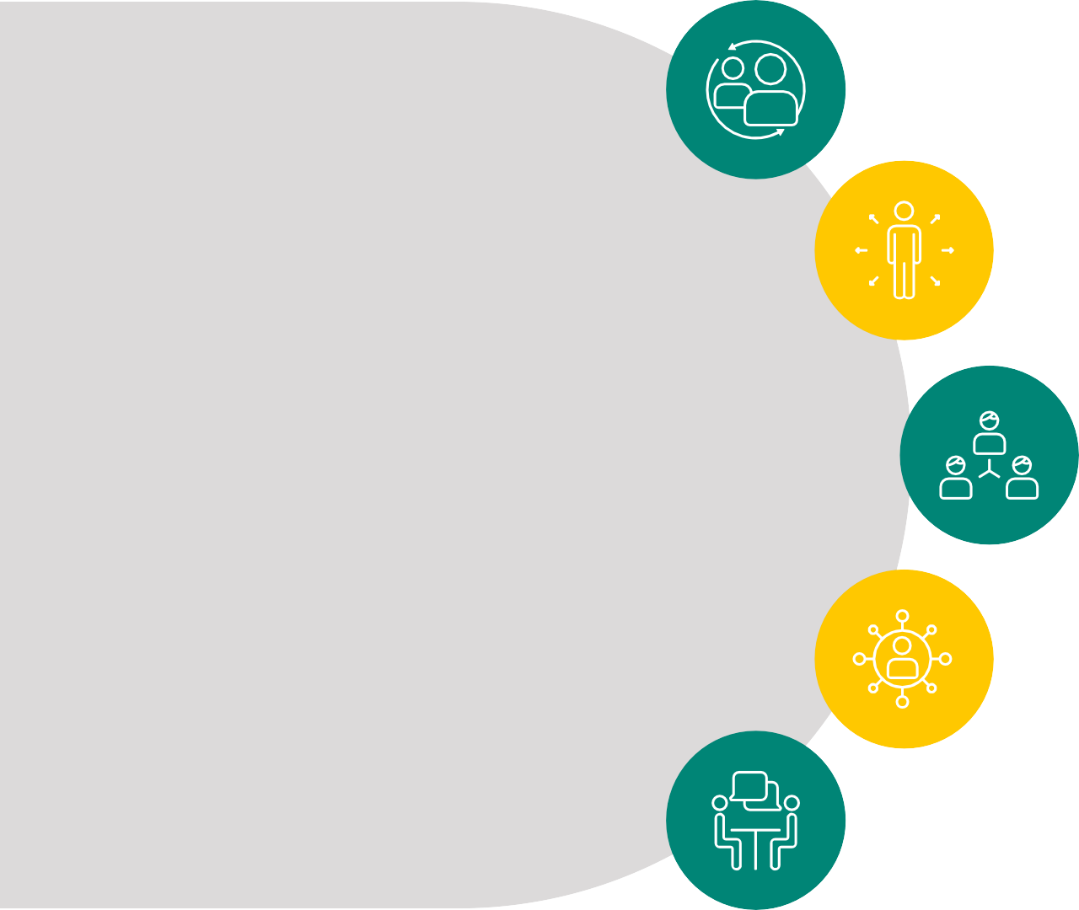
Committed towards Social Cause
Trident Foundation
Launch of our NGO- Trident Foundation to help the needy and social cause. It includes donations, medical aids to tribal areas in Budhni, adoption, blood donation program, etc.
Opportunities for Farmers
Motivated farmers to sell wheat straw waste and prevented it from burning in open
fields.
Village cluster adoption – 200 Villages & More than 26,500 hectares of
land and 17,498 farmers impacted
Women Empowerment
Revamp existing facilities, provide infrastructure and basic facilities to 250 schools and anganwadis.
Sewing machines and handicrafts-making training under Hastakala
initiative for women in Talpura, Jahanpur & Mahukala
Nirmal Narmada Abhiyan
Cleaning of Narmada river every quarter in order to provide clean water and area to the locals resulting removal of 35MT plastic waste.
Initiatives towards Society
Medical Facilities
Vending machines to obtain free sanitary napkins.
Free consultations and medication for more than 100,000
people in rural areas.

Slide 14








01
Efficient Corporate Governance
3 times National Recognition for Good Corporate Governance
02
1 National Award for Excellence in Corporate Governance
03
2 times stood among the Top 25 Indian Corporates adopting Good Corporate Governance
India Rating AA (Positive Outlook):
Non- Convertible
Debentures
CARE
AA (Positive Outlook):
LT Borrowings
A1+: ST Borrowings
CRISIL
AA (Stable Outlook): LT Borrowings
A1+: ST Borrowings
D&B
5A1: Business Rating

Slide 15
Future prospects
Vision 2025 3 BHAGs (BIG, HAIRY, AUDACIOUS GOALS)
OBJECTIVES IMPERATIVES
Unlock long term shareholder value
🗸
Improve return ratios through capital allocation strategies
Grow to Rs 250,000 Mn by
2025 with 12%
bottom line as a business group
1
Grow core business
Capitalize on recent growing retail trends - Online & Offline
🗸
Expansion of existing businesses through
organic and inorganic growth
Brands
🗸
Creation of focused business groups to generate
synergies and explore business alliances
2
Develop robust processes & organisation
Boost efficiency, simplify & automate processes
🗸
Optimization of leveraging capacity to create value
Making Trident a
National Brand
🗸
3
Build new businesses
Diversify, build and grow new businesses through organic and
Penetration into new markets
Digital Trident- Manoeuvring through Industry
4.0 Journey
🗸
Product development
inorganic growth
🗸
E-commerce
4
Digital & industry 4.0
IOT, Blockchain & Digitalization
🗸
Brand building

Slide 16


THANK YOU
Earnings Presentation Q4 FY22

